Slide 1
Chapter 9. Deep Learning-Based
Technology for Versatile Video Coding (VVC, H.266)

Slide 2
Outline
Introduction
Deep schemes and deep tools
Coding strategies
CNN-based coding tools
Network structure
CNN-BRAC
Concluding remarks

Slide 3
Introduction
The prior arts for versatile video coding (VVC) include two categories: (1) new coding schemes built solely upon deep networks (deep schemes), and (2) deep network-based coding tools embedded into traditional coding schemes (deep tools).
Deep schemes for image coding have currently achieved good compression efficiency, whereas deep schemes for video coding do not reach the compression efficiency of HEVC. Recently, several deep tools have achieved noticeable coding gains over HEVC.
Three promising deep tools for VVC, namely, neural networks (NN)-based intra prediction, convolutional neural networks (CNN)-based in-loop filtering, and CNN-based block-adaptive-resolution coding with some experimental results are described.

Slide 4
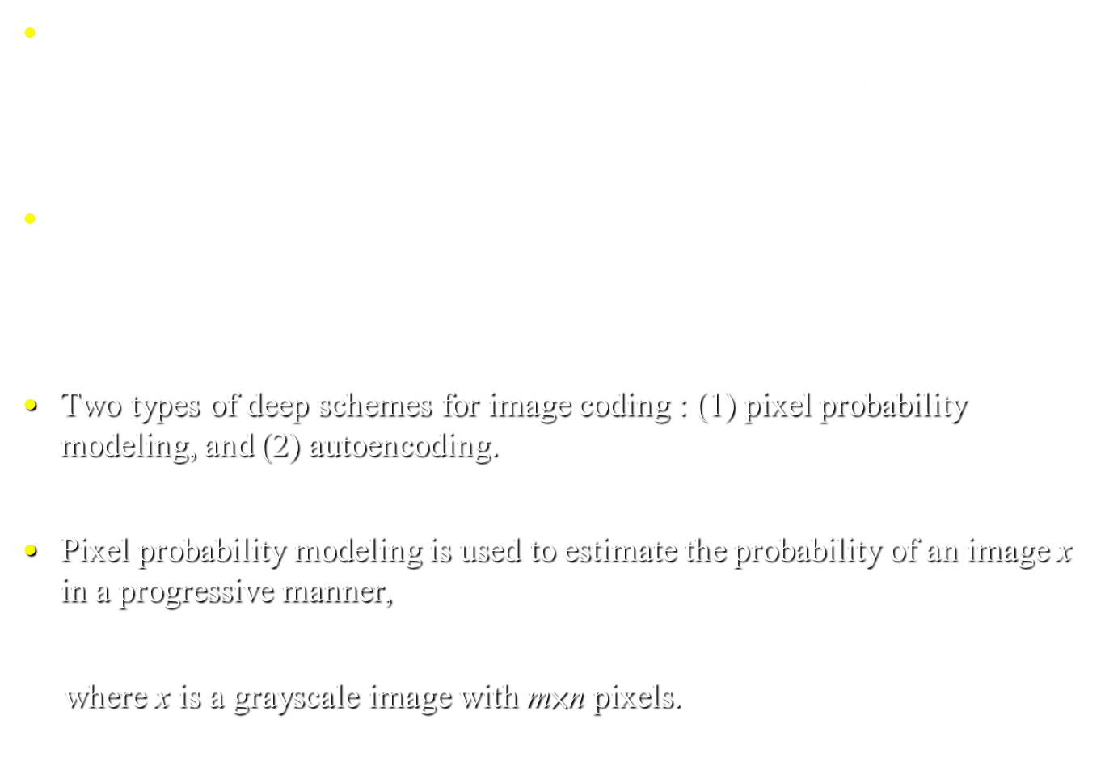
Deep schemes
Let the pixels be arranged in the raster scan order, and x_{i} be the i-th pixel. It is difficulty is to estimate the conditional probability p(x_{i} | x₁,..., x_{i−1}) given the previous pixels x₁,..., x_{i−1}.
A combination of deep network-based probability estimation and entropy coding (e.g., arithmetic coding) provides a deep lossless image coding scheme [9].
Two types of deep schemes for image coding : (1) pixel probability modeling, and (2) autoencoding.
Pixel probability modeling is used to estimate the probability of an image x in a progressive manner,
$p\left(x\right)=Π_{i=1}^{m×n}p\left(\left.x_{i}\right|x_{1},…,x_{i^{−1}}\right)$,
where x is a grayscale image with m×n pixels.
(1)

Slide 5
Deep schemes (cont.)
Autoencoders containing two sub-networks are originally developed for dimensionality reduction with neural networks [31]. The encoder sub-network converts a datum to features, and the decoder sub-network converts features back into the data domain.
In [10, 11], RNN-based methods are proposed for variable rate image coding by iterating RNN multiple times analogous to a scalable coding scheme.
For the CNN-based method in [12], the network features a new nonlinear function (generalized divisive normalization), and is optimized with a loss function that resembles the joint rate-distortion cost. In addition, the quantized features are compressed by context-adaptive binary arithmetic coding.

Slide 6
Deep tools
Deep prediction tools include methods for intra-picture prediction, inter-picture prediction, and cross-channel prediction.
For intra-picture prediction, both fully-connected networks and CNN-based methods are proposed.
For inter-picture prediction, several works are proposed for fractional-pixel interpolation, while other works are proposed for bi-directional motion compensation, motion compensation refinement, combined intra/inter prediction, or directly extrapolating a frame for reference.
For cross-channel prediction, a multiple hypothesis method is proposed to predict chroma components from luma components [39], and a hybrid network-based method is presented to combine hints of collocated luma and neighboring chroma [24].

Slide 7
Deep tools (cont.)
For transform tools, a CNN-based DCT-like transform is studied for image compression [25], which is virtually an autoencoder.
In [40], an autoencoder is proposed for compressing the motion predicted residues in video coding, and the quantized features are compressed by Huffman coding.
Deep entropy coding tools are proposed to estimate the probabilities of predefined syntax elements, including intra prediction mode, quantized coefficient, and transform index.

Slide 8
Deep tools (cont.)
Deep post-processing tools are applied solely at the decoder to improve reconstruction quality [44–47], whereas deep in-loop filtering tools are applied inside the coding loop [27, 48–50].
Deep down- and up-sampling-based coding tools are based on deep learning-based superresolution [4].
Deep block-adaptive-resolution coding (BARC) tools are proposed for intra frames, inter frames, and motion predicted residues [28, 52-54].
Deep encoding optimization tools are used only at the encoder for fast mode decision, rate control, deciding region-of-interest, and so on.

Slide 9
Intra prediction
In [59], a fully connected neural network containing three hidden layers is used to generate prediction signals for the current block using its neighboring reconstructed pixels.
Another fully connected network [59] is used to predict the probabilities of different modes for the current block using its neighboring reconstructed pixels.
Prediction signal can be generated in the transformed domain, and a set of non-separable transforms can be used to compress the prediction residues for different modes [59].

Slide 10
In-loop filtering
In Zhou et al. [60], a trained CNN network is used as the only in-loop filter before the adaptive loop filter. CNN replaces the bilateral filter, deblocking filter, and sample adaptive offset for intra frames.
The reconstructed pixel values and the quantization parameter (QP) map [60] are fed into the CNN network containing eight convolutional layers with rectified linear units (ReLU).
A CNN-based in-loop filter [61] is proposed to deal with inter frames, in which a binary flag is signaled for each 64×64 block to indicate whether the CNN-based filter is used or not.

Slide 11
In-loop filtering (cont.)
In Wu et al. [62], an alternative CNN-based in-loop filter is applied after deblocking filter and before sample adaptive offset.
This CNN [62] has 34 convolutional layers organized into 16 blocks with residue connections. A binary flag is signaled for each coding tree unit (CTU) to indicate whether the CNN-based filter is used or not.
For the CNN-based in-loop filter [63], the reconstructed pixel values, the prediction signal, and the compressed residue signal are fed into the CNN-based filter containing 8 layers, which is applied after the adaptive loop filter.
Multi-level flags are signaled to indicate whether the CNN-based filter is used or not. At the slice level there are three modes: slice-all-on, slice-all-off, and CTU-level-decision [63].

Slide 12
Down- and up-sampling-based coding
In Bull et al. [51], a CNN-based down- and up-sampling-based coding tool is described. Spatial down-sampling is performed via a fixed linear kernel, and the bit-depth reduction is achieved by right shift.
At the decoder, multiple CNN models are trained for spatial up-sampling, bit-depth up-sampling, or joint up-sampling. This CNN network consists of 20 layers with ReLU [51].
In [62], a CNN-based down- and up-sampling-based coding tool is applied at the CTU level, and a binary flag is signaled for each CTU to indicate whether the tool is used or not.

Slide 13
Fast algorithm for block partitioning
A CNN-based tool for quickly determining the block partitioning structure is described in [65], which may be quadruple tree-based partitions (as in HEVC), binary tree-based partitions, or triple tree-based partitions.
The CNN-based block partitioning tool [65] takes a CTU as input, considers all the possible borders inside the CTU, and outputs the probability that each possible border is a designated border.

Slide 14

Statistical learning paradigms
Statistical learning includes regression, classification, and density estimation [66].
For density estimation, i.e., given a dataset of observations ${\left.x_{i}\right|}_{i=1}$about a random variable x, we need to estimate the probability distribution p(x). By the maximum likelihood criterion, an estimator can be
$q^{∗}\left(x\right)=$ arg $\min{Σ_{ⅈ=1}^{N}}−\log{q\left(x_{i}\right)}$.
N
(2)
q(x)

Slide 15

Statistical learning paradigms (cont.)
For classification, we are given a dataset (x_{i}, y_{i})|_{i=1} for two related variables, x and y, and y_{i} ∈ N, N is the set of natural numbers. The goal is to identify a function $\hat{y}$ = f (x) relating x and y.
For coding, let x_{i} be a signal and y_{i} be its corresponding code. A statistical learning technique is used to achieve a function that converts a signal into its code.
N

Slide 16
Coding strategies
The current video coding schemes, such as HEVC, are known as hybrid coding schemes containing two strategies: predictive coding and transform coding.
Predictive coding can be described as a supervised learning task, i.e., a regression or classification task.
Intra-picture prediction, inter-picture prediction, cross-channel prediction, probability estimation for entropy coding, post-processing, and in-loop filtering, are regression tasks, whereas fast mode decision can be regarded as a classification task.

Slide 17
Coding strategies (cont.)
Transform coding and autoencoder are actually unsupervised learning tasks, i.e., deep transform tools are similar to the autoencoder [25, 40].
The joint training of down- and up-sampling resembles an autoencoder [52], and can be viewed as a transform coding tool.
Neural networks are universal approximators, i.e., they can approximate any practically useful function [68], appealing in machine learning tasks.
Video coding is a highly nonlinear process mapping a video into a number of bits. Recently, many deep tools are used to indirectly build up deep schemes.

Slide 18
NN-based intra prediction
An NN-based (neural network based) intra prediction tool, namely, matrix-based intra prediction (MIP) [69] has been adopted into VVC. In VVC, block partitioning is more flexible, i.e., blocks of different sizes.
The process of MIP for 8×4 blocks [69] is depicted in Fig. 1, which consists of three steps: reference pixel averaging, affine prediction, and linear interpolation.

Slide 19
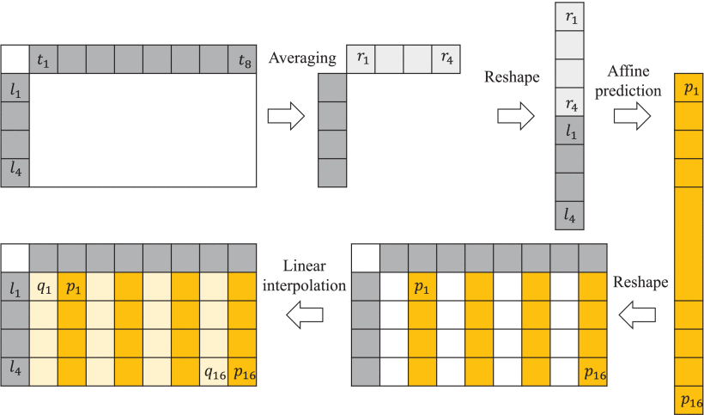
NN-based intra prediction (cont.)
Fig. 1. Illustration of the matrix-based intra prediction (MIP) [69] for 8×4 blocks.

Slide 20
NN-based intra prediction (cont.)
In the first step, the reference pixels include the row above the target block (i.e., t₁,...,t₈) and the column to the left (i.e., l₁,...,l₄). And t₁,...,t₈ are locally averaged into r₁,...,r₄, which are then combined with l₁,...,l₄ to form an 8-dimensional (8D) vector.
In the second step, an affine operation is used to calculate a 16D vector from the input 8D vector, i.e.,
[p₁,…,p₁₆]^{T} = A_{k}[r₁,…,r₄,l₁,…,l₄] + b_{k ,}
In the third step, a linear interpolation is performed by using l₁,…,l₄ and p₁,…,p₁₆ to generate q₁,..., q₁₆ (the pixels at even columns).
(3)
where A_{k} is a 16×8 weight matrix and b_{k} is a 16D bias vector, both of which are achieved by offline training, and k indicates prediction mode. The 16D vector is then used to fill in the pixels at odd columns of the target block.

Slide 21
NN-based intra prediction (cont.)
In [69], for 8×4 blocks, the affine operation generates 16 pixels and the linear interpolation generates the remaining 16 pixels. For affine operation, the sizes of the weight matrix and the bias vector are d_{out}×d_{in} and d_{out}×1, respectively, where d_{in} and d_{out} are the input and output dimensions, respectively.
Typical results of MIP compared to VTM version 4.0 are summarized in Table 1. Under all-intra configuration, the BD-rate reductions are 0.79% and 0.82% for the two settings, respectively.

Slide 22
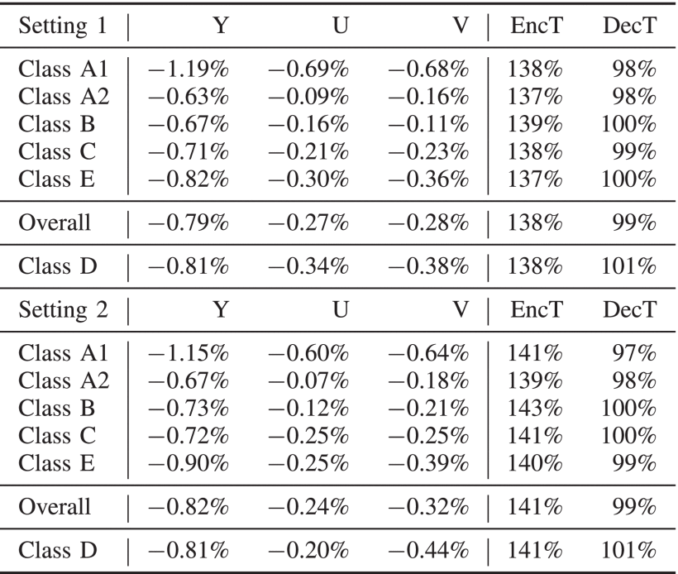
NN-based intra prediction (cont.)
Table 1. Results of MIP compared to VTM 4.0 under all-intra configuration.

Slide 23
CNN-based in-loop filtering
In this study, a CNN-based in-loop filtering tool, namely, the dense residual network-based in-loop filter (DRNLF) [71] is described.
There are multiple in-loop filters in VVC, including the deblocking filter (DF), sample adaptive offset (SAO), and adaptive loop filter (ALF).
In VCC, as shown in Fig. 2, DRNLF [71] is as an additional filter placed after DF and before SAO and ALF. DRNLF uses rate-distortion optimization (RDO) to decide whether the CNN-based filter at the CTU level with binary flags will be applied or not.

Slide 24
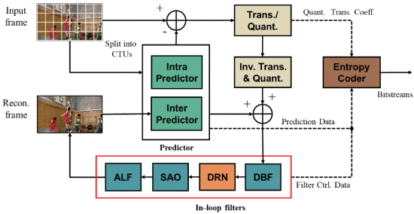
CNN-based in-loop filtering (cont.)
Fig. 2. The proposed decoding scheme integrating DRNLF [71] for VCC.

Slide 25
Network structure
In [71], the network contains several dense residual units (DRUs). Each DRU consists of one 1×1 convolutional layer, one ReLU, and two 3×3 convolutional layers, as shown in Fig. 3.
There are two shortcuts in a DRU [70]. The inner shortcut performs residual learning by adding up the outputs of the 1×1 convolutional layer to the last 3×3 convolutional layer. The outer shortcut directly passes the original input to the next unit.
If x denotes the input of a DRU, the output of the DRU is defined as
F_{DRU}(x) = H(x, g(x) + f(g(x))),
(4)
where H(·) denotes the concatenation operation, g(·) represents the 1×1 convolutional layer, and f (·) represents the two 3×3 convolutional layers.

Slide 26
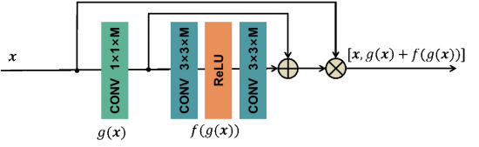
Network structure (cont.)
Fig. 3. The dense residual unit (DRU) in [70], where “+” and “×” stand for addition and concatenation, respectively.

Slide 27
Network structure (cont.)
To reduce the data volume generated by shortcuts, the 1×1 convolutional layer (as a bottleneck layer) is used to effectively reduces the number of channels and the number of parameters.
Compared with the dense residual network (DRN) shown in Fig. 4 [70], in [71], the 3×3 (conventional) convolutional layer is replaced by the 3 × 3 depth-wise separable convolutional (DSC) layer in each DRU, as the revised DRN depicted in Fig. 5.

Slide 28
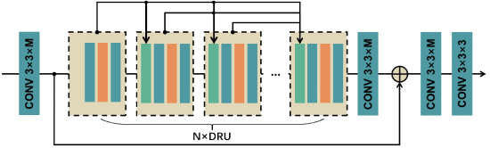
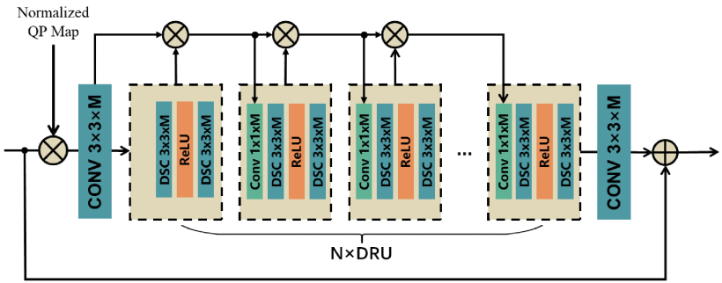
Network structure (cont.)
Fig. 4. The dense residual network (DRN) in [70].
Fig. 5. The revised DRN in [71].

Slide 29
Network structure (cont.)
First, there are four conventional layers in Fig. 4, but only two in Fig. 5.
Second, a normalized QP map concatenated with the reconstructed frame is used as the inputs to the revised DRN in Fig. 5. But in Fig. 4, only the reconstructed frame is used as the input.
Third, the number of DRUs is reduced from 8 in Fig. 4 to 4 in Fig. 5 and the number of convolution kernels is reduced from 64 in Fig. 4 to 32 in Fig. 5, respectively.

Slide 30
Network structure (cont.)
For training, first, multiple models are trained for different QPs {22, 27, 32, 37} in [70], but only one model is trained in [71]. Second, the training data are in the RGB color space in [70], but in the YUV color space with weights 10:1:1 in [71].
As shown in Table 2 in [71], under all-intra configuration, the BD-rate reduction is 2.34%. However, the decoding time increase is huge.
Table 3 gives a summary of the tests in [71]. Table 4 shows the overall BD-rate results of Test 1 (using Fig. 4 in [70]) and Test 2 (using Fig. 5 in [71]).

Slide 31
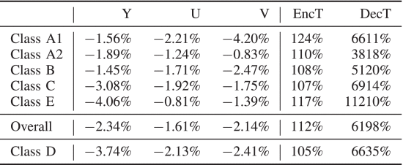
Network structure (cont.)
Table 2. Results of DRNLF [71] compared to VTM 2.0.1 under all-intra configuration.

Slide 32
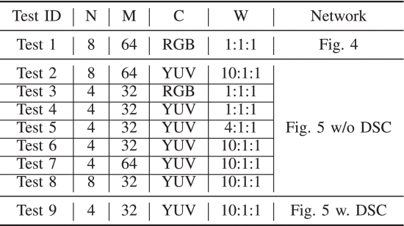
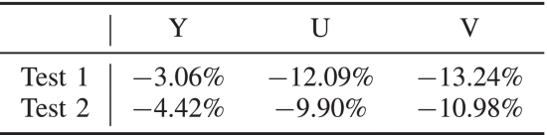
Network structure (cont.)
Table 3. Different test conditions for DRNLF, where N and M denote the numbers of DRUs and convolutional kernels, respectively, C denotes the color space of the training data, and W denotes the weights of components.
N
M
C
W
Table 4. Comparison of test 1 [70] and test 2 [71].

Slide 33
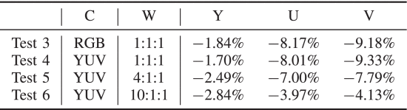
Network structure (cont.)
In Table 5, Test 3 is trained on RGB images with weights of 1:1:1, and Tests 4–6 are trained on YUV images with weights of 1:1:1, 4:1:1, 10:1:1, respectively [71].
Table 5. Comparison of training data and loss function for DRNLE [71].
C
W

Slide 34
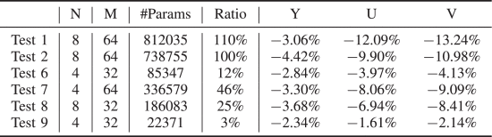
Network structure (cont.)
In Table 6, tests 2 and 6–9 are conducted to investigate the networks configured with different hyper-parameters (N and M).
As shown in Fig. 6, the BD-rate in general decreases as the number of parameters decreases.
Table 6. Comparison of networks for DRNLE [71].
N
M

Slide 35
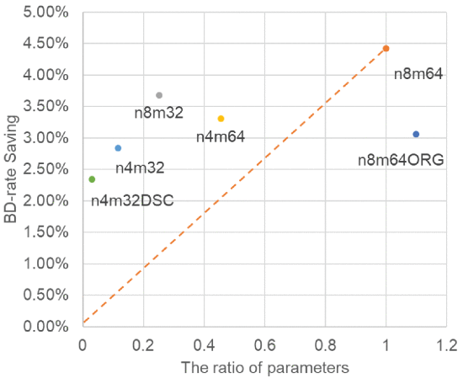
Network structure
Fig. 6. The relationship between BD-rate saving (Y channel) and the number of parameters (shown in ratio), see also Table 6.

Slide 36
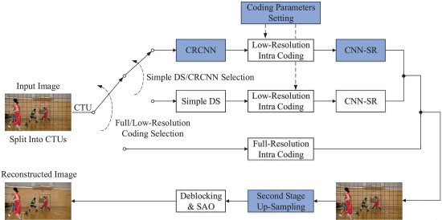
CNN-BARC
The proposal [51] performs down- and up-sampling at frame and GOP levels, while block-adaptive-resolution coding (BARC) [62] performs down- and up-sampling at block level.
The BARC scheme for intra frames with CRCNN and CNN-SR is depicted in Fig. 7.
Fig. 7. The proposed CNN-based block-adaptive-resolution coding (BARC) scheme based on HEVC. Note the blue colored blocks.

Slide 37
CNN-BARC (cont.)
For CNN down-sampling, to compare the original image and the low-resolution (i.e., compact-resolved) image, two loss terms are designed to compare them at two resolutions, respectively.
First, the reconstruction loss is defined as
J_{rec} = ||g( f (x)) − x||²,
(7)
where f and g denote the mapping functions for compact-resolution CNN (CRCNN) and up-sampling, respectively, and x is the original image.

Slide 38

CNN-Based block-adaptive-resolution coding
Second, the regularization loss is defined as
J_{reg} = ||f (x) − F(x) ||²,
Combining Eqs. (7) and (8), the loss function for training is defined as
J = J_{rec} + $λ⋅$ J_{reg} = ||g( f (x)) − x||² + $λ$ $⋅$||f (x) − F(x) ||².
(8)
where F is the predefined down-sampling operation.
(9)

Slide 39
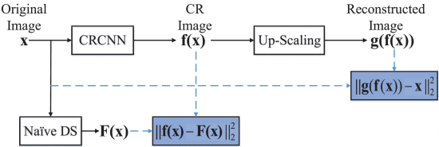





CNN-Based block-adaptive-resolution coding (cont.)
x
$$f\left(x\right)$$
up-sampling
$$g\left(f\left(x\right)\right)$$
$${\left\|g\left(f\left(x\right)\right)−x\right\|}_{2}^{2}$$
$$F\left(x\right)$$
$${\left\|f\left(x\right)−F\left(x\right)\right\|}_{2}^{2}$$
Fig. 8. The proposed scheme for training compact-resolution CNN (CRCNN) with two loss terms.

Slide 40
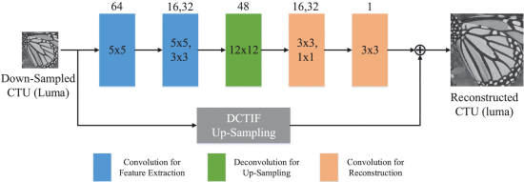
CNN-SR
A convolutional neural network for superresolution (CNN-SR) is adopted to bring the down-sampled coded CTU to its original resolution, as shown in Fig. 9.
Fig. 9. The network structure of CNN-SR for up-sampling the luma component.

Slide 41
Concluding remarks
Deep tools are typically developed to replace modules of hybrid video coding schemes, which can be combined into a larger network with further fine-tuning. Few existing works have considered specific optimization for perceptual quality.
In this study, three promising deep coding tools, namely, NN-based intra prediction, CNN-based in-loop filtering, and CNN-based block-adaptive-resolution coding, are described.

